Slide 1
Demoliton of 15 More Structure in Cappadocia Starts
Kemal Berke Yılmaz 820220714 Computer Engineering yilmazk21@itu.edu.tr
Muhammed Selim 820210406 Economics and Finance polatmuha21@itu.edu.tr
Kerem Taşkın 820220659 taskink@itu.edu.tr

Slide 2
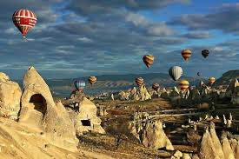
You know,Capadocia is an important historical place in Turkey.

Slide 3
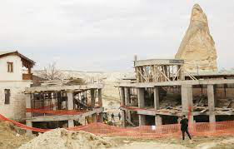
On the other hand there are some skew settlements in Capadocia.

Slide 4
A commission has been recently assigned by Turkish Culture and Tourism Ministry to explore the Cappadocia area and to detect illegal constructions. The move came after a public uproar at a hotel construction at the area. The ministry then announced that the construction of the hotel was stopped and the next day on Feb. 14 the demolition works kicked off. (Daily News,2019)

Slide 5
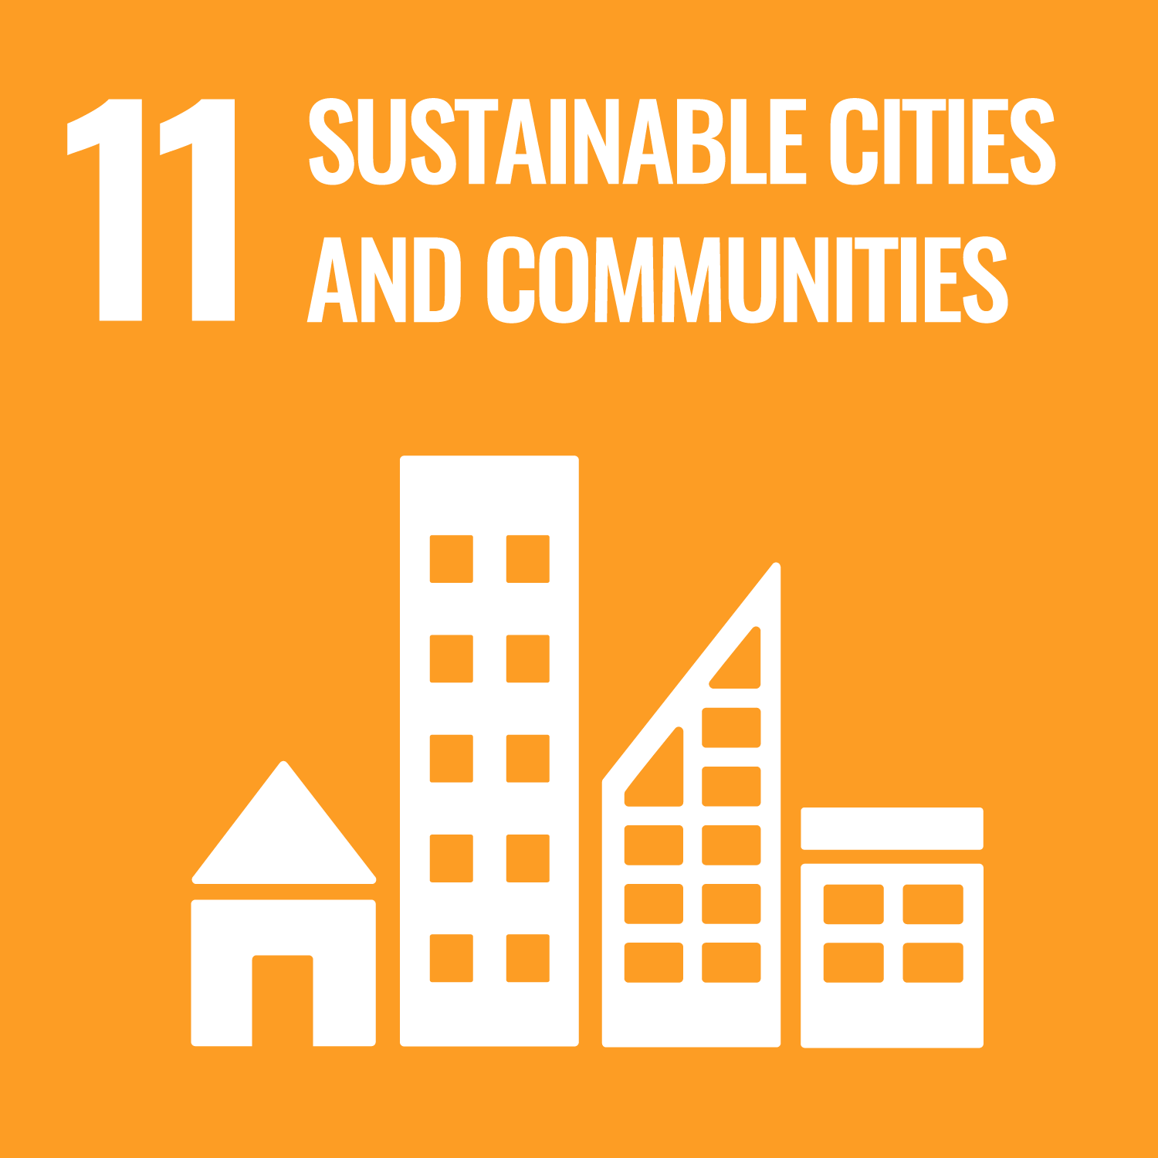
What is SDG 11-1?
By 2030, ensure access for all to adequate, safe and affordable housing and basic services and upgrade slums

Slide 6
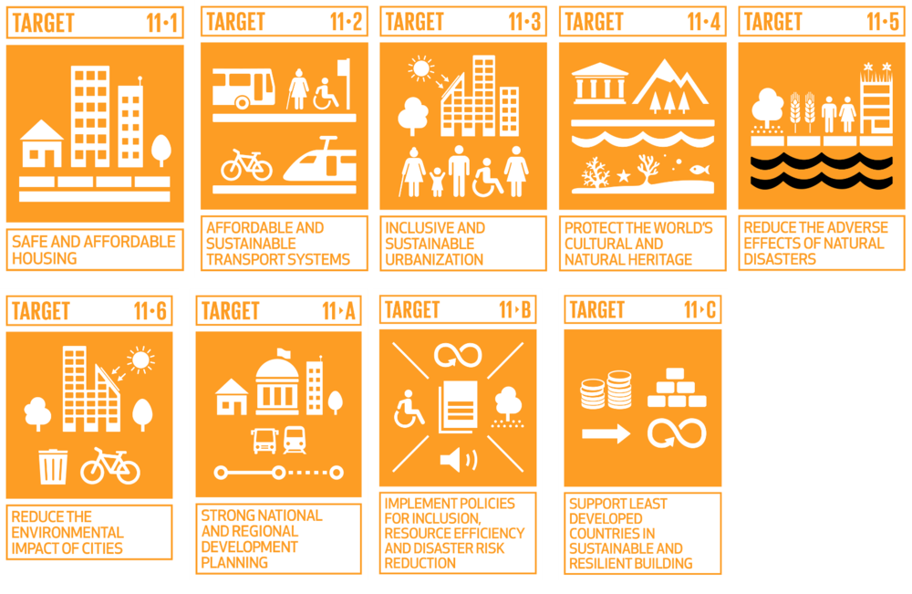

Slide 7
As you know Sustainable Development Goals aims to make cities and human settlements inclusive, safe, resilient and sustainable but skew settlements is not a kind of them.

Slide 8
.Luckily a commission has been recently assigned by Turkish Culture and Tourism Ministry to explore the Cappadocia area and to detect illegal constructions. The move came after a public uproar at a hotel construction at the area. The ministry then announced that the construction of the hotel was stopped and the next day on Feb. 14 the demolition works kicked off. (Daily News,2019)

Slide 9
But they waited to increase of the reaction of public instead of doing regular controlls.

Slide 10
If they would do these controls,the place which has 10000+ years history hadn’t been damaged.

